Slide 1
Easy Quote
Daisy Du

Slide 2
Contents
Modules
Functions
Instructions

Slide 3
Functions
Core System
Motor/ Non-Motor Insurance
Amend
Query
Configure
Quote

Slide 4

Landing Pages

Slide 5
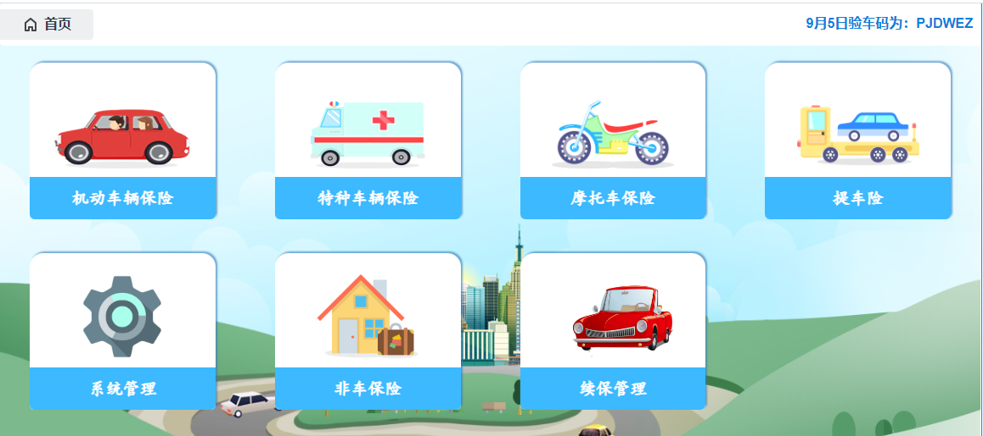
Modules
Special-vehicle Insurance
Motorbike Insurance
Renewal Management

Slide 6
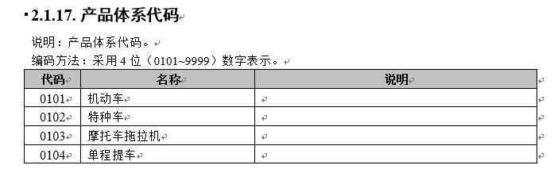
Modules
Special-vehicle Insurance
Motorbike Insurance
Renewal Management

Slide 7

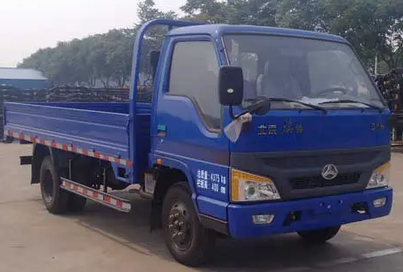


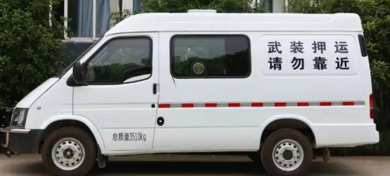
Modules
Ordinary
Motor Vehicle
Special
armor cash carrier
Different rates and codes defined by CBIRC (China Banking and Insurance Regulatory Commission)

Slide 8
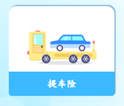
Modules
One-way pickup insurance covers the accidents in the process of temporarily moving an unsold car from one place to another.
Transportation process from the manufacturer to the dealer, from the upper dealer to the lower dealer.
Short insurance period (10 or 30 days)

Slide 9
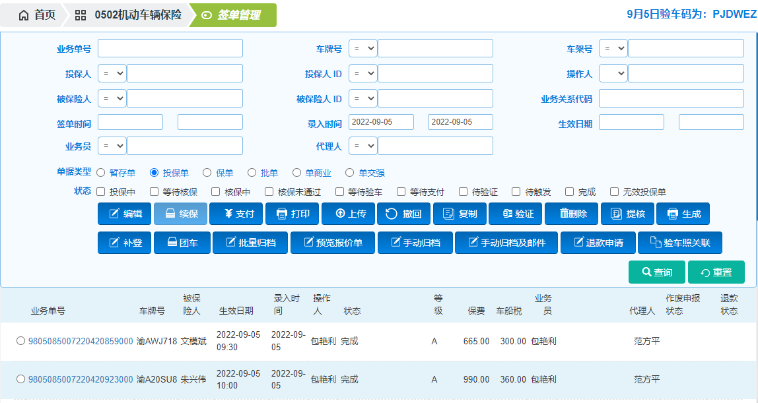
Brief Instructions – Query
Query Condition:
Business number
license plate number
Vin number
policy holder name/ ID
Insured person name/ ID
Operator
Salesman
Agent
Sign date
Input date
Effective date

Slide 10
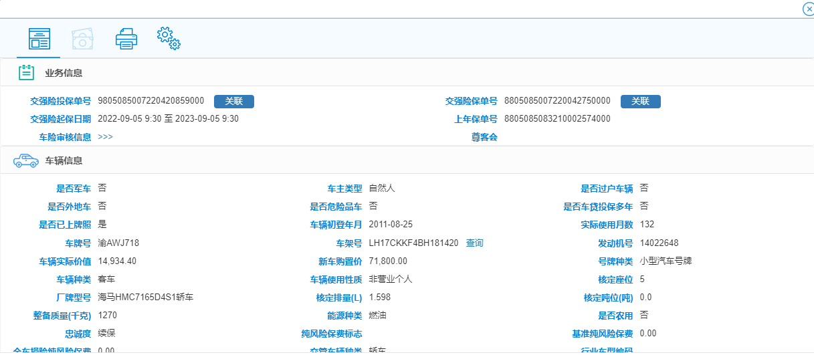
Brief Instructions – Query
Information about :
Business number
Insurance period
Vehicle
Customer
Channel
Vehicle and vessel tax
Discount
Coverages
Premium

Slide 11
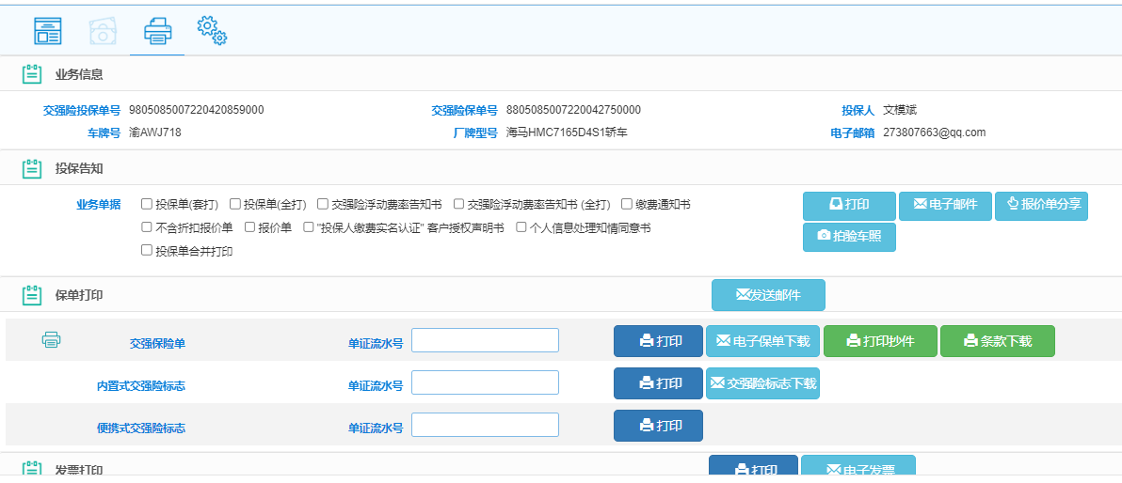
Brief Instructions – Query
Download related documents
(notification, price sheet, policy)

Slide 12
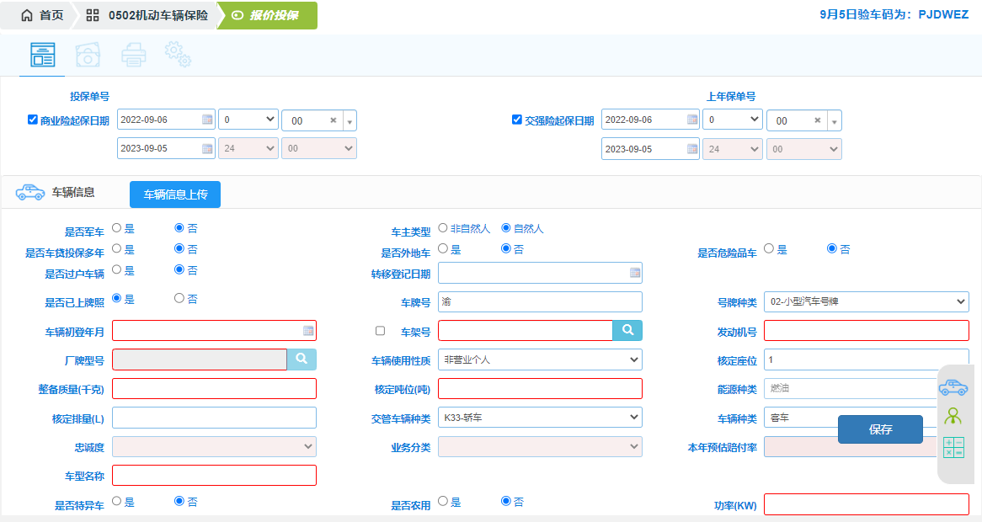
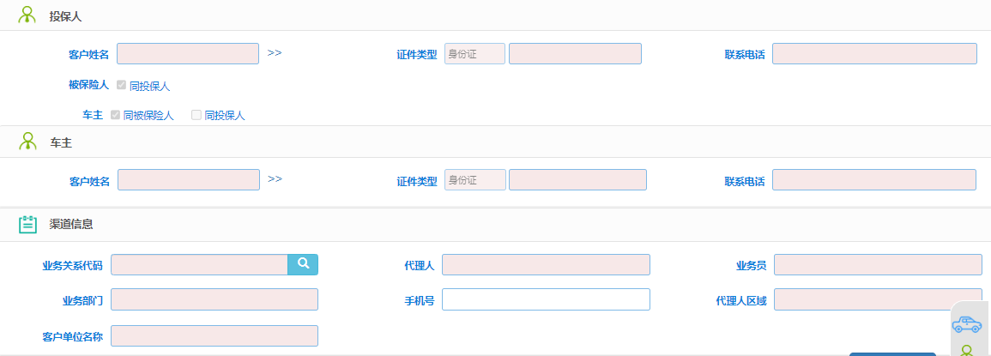
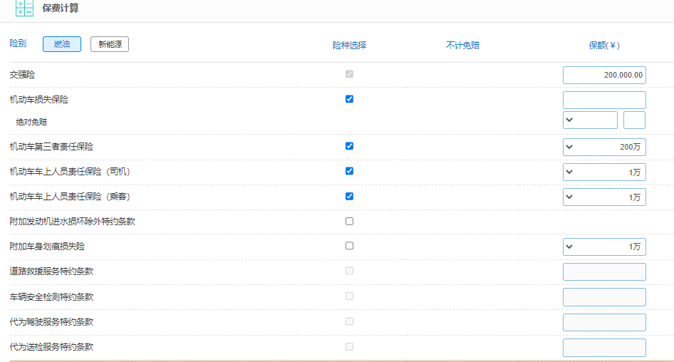
Brief Instructions – Quote
Fill in by operator :
Insurance period
Vehicle
Customer
Channel
Coverages
Calculate by System:
Vehicle and vessel tax
Discount
Premium

Slide 13
Brief Instructions – Amend
To change information :
Vehicle
Customer
Coverages
1) add or delete insured coverages
2) add or decrease amount
Amend the information of insurance
Cancel the insurance

Slide 14
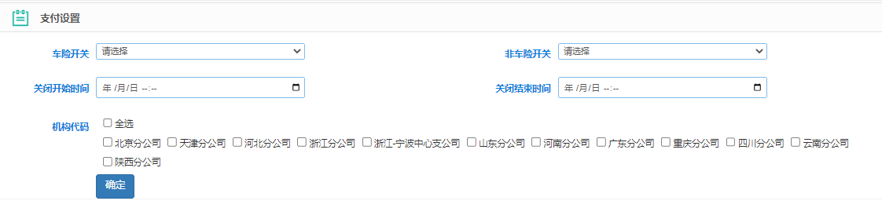
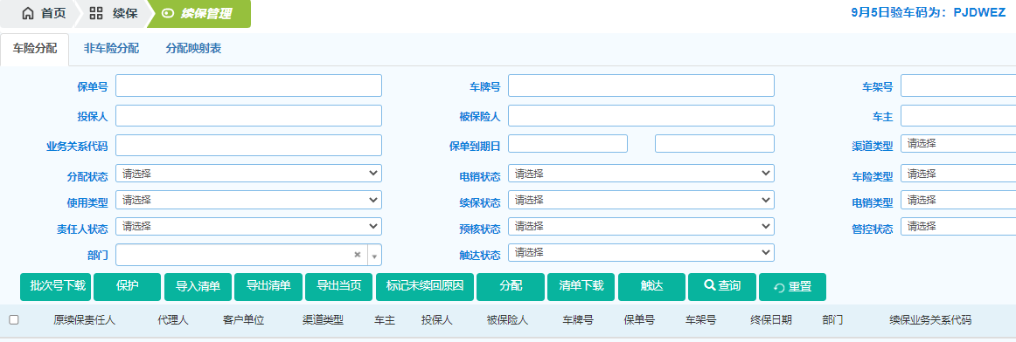
Brief Instructions – Configure
System configuration, such as payment on-off.
Some function configuration, such as renewal managements

